Slide 1
Variational Autoencoders

Slide 2
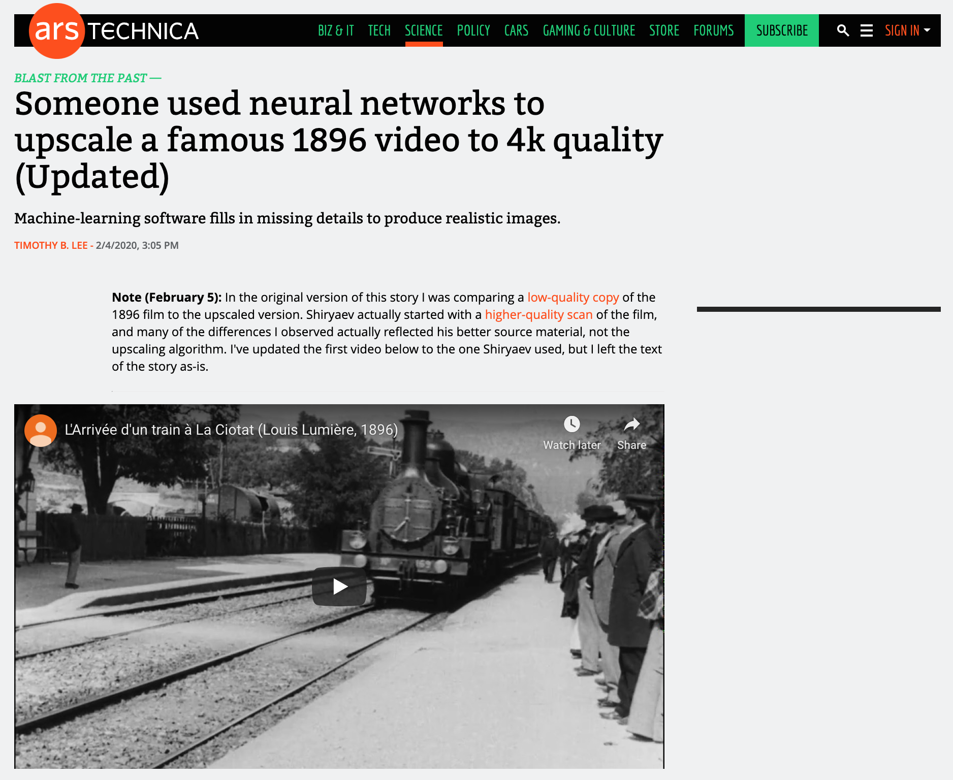

Slide 3
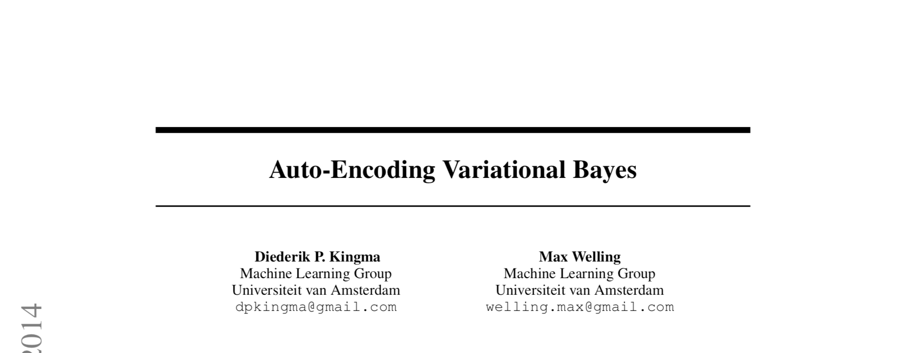
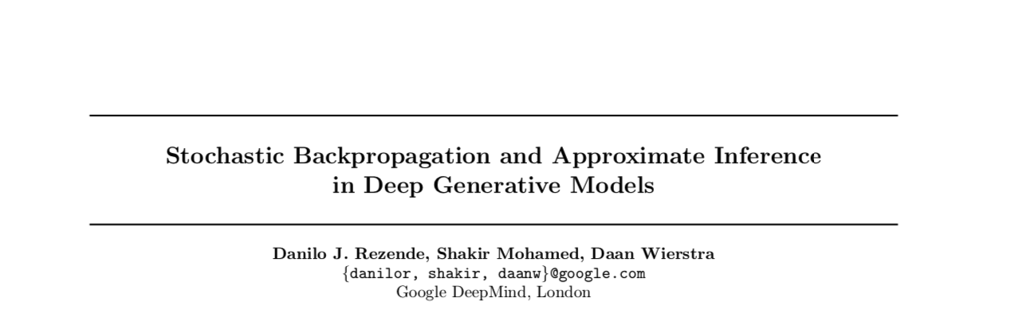
A note on credit

Slide 4
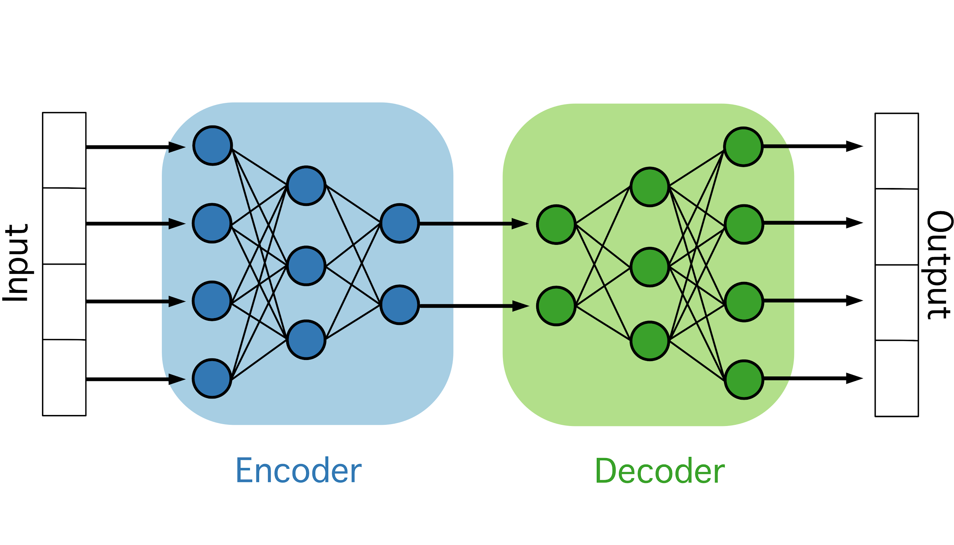
Overview of the Autoencoder

Slide 5
Autoencoder uses
Find compressed space for efficient transmission of signals (bottleneck)
Denoising: train on noiseless reconstruction

Slide 6
Autoencoder uses
Find compressed space for efficient transmission of signals (bottleneck)
Denoising: train on noiseless reconstruction
What if we want to create novel outputs instead of just reconstructions?

Slide 7
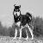
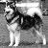
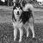
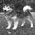
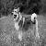
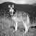
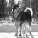
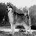
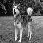
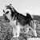
The setup: Goals of the variational autoencoder (VAE)
Learn the underlying structure of data to create novel observations

Slide 8
Some bookkeeping for the examples
0.388
0.914
0.255
0.047
0.235
0.216
1
0.992
0.337
0.102
0.227
0.388 | 0.72 | 0.811 | 0.956 | 1
0.913 | 0.952 | 0.784 | 0.956 | 0.992
0.254 | 0.364 | 0.349 | 0.298 | 0.337
0.047 | 0.058 | 0.074 | 0.050 | 0.101
0.258 | 0.266 | 0.235 | 0.215 | 0.227
M
MxN
M
...
N
N

Slide 9
Some bookkeeping
X
x_{i}
x_{n}
0.388
0.914
0.255
0.235
0.216
0.992
0.337
0.227
0.388
0.914
0.255
0.235
0.216
0.992
0.337
0.227
0.388
0.914
0.255
0.235
0.216
0.992
0.337
0.227
0.388
0.914
0.255
0.235
0.216
0.992
0.337
0.227
...
...
...
...
...

Slide 10
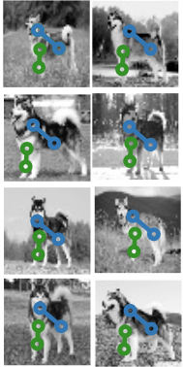

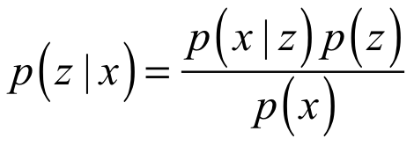
A toy example of the posterior density
Pixel variable z

Slide 11
The posterior
likelihood x prior
posterior =
evidence

Slide 12
The posterior
likelihood x prior
posterior =
evidence
Also called the Marginal Likelihood

Slide 13
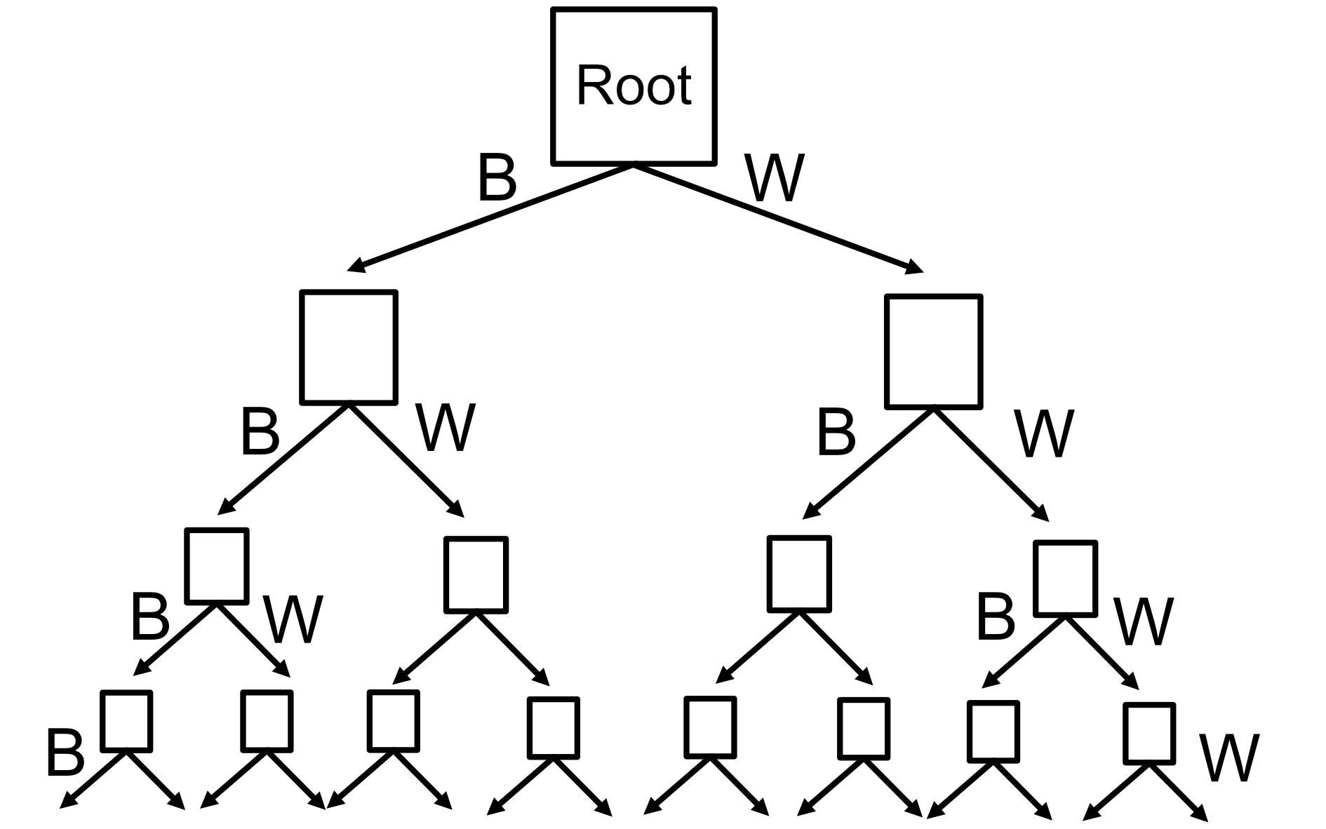
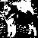
The pesky p(x): toy example with first 4 pixels
Binarized malamute:
2^2500

Slide 14
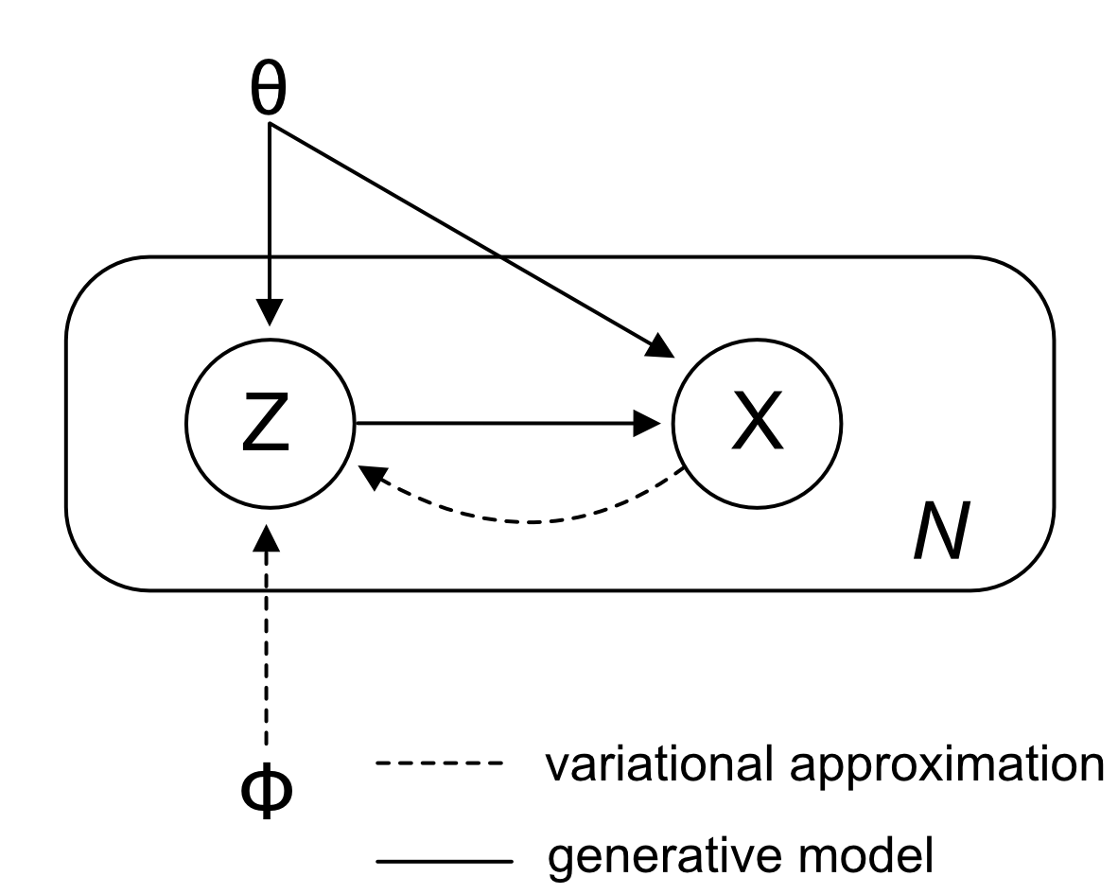
Getting a grip on the graphical model

Slide 15
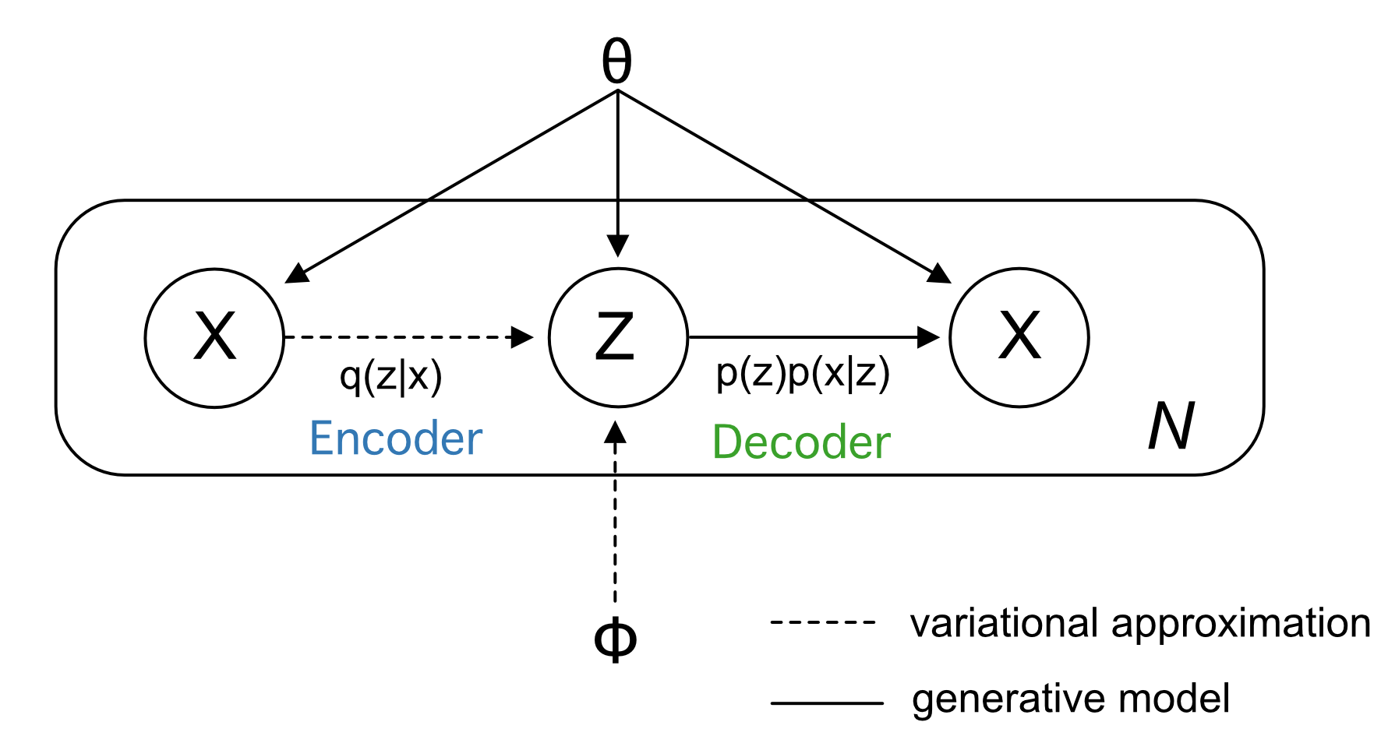
This makes more sense

Slide 16
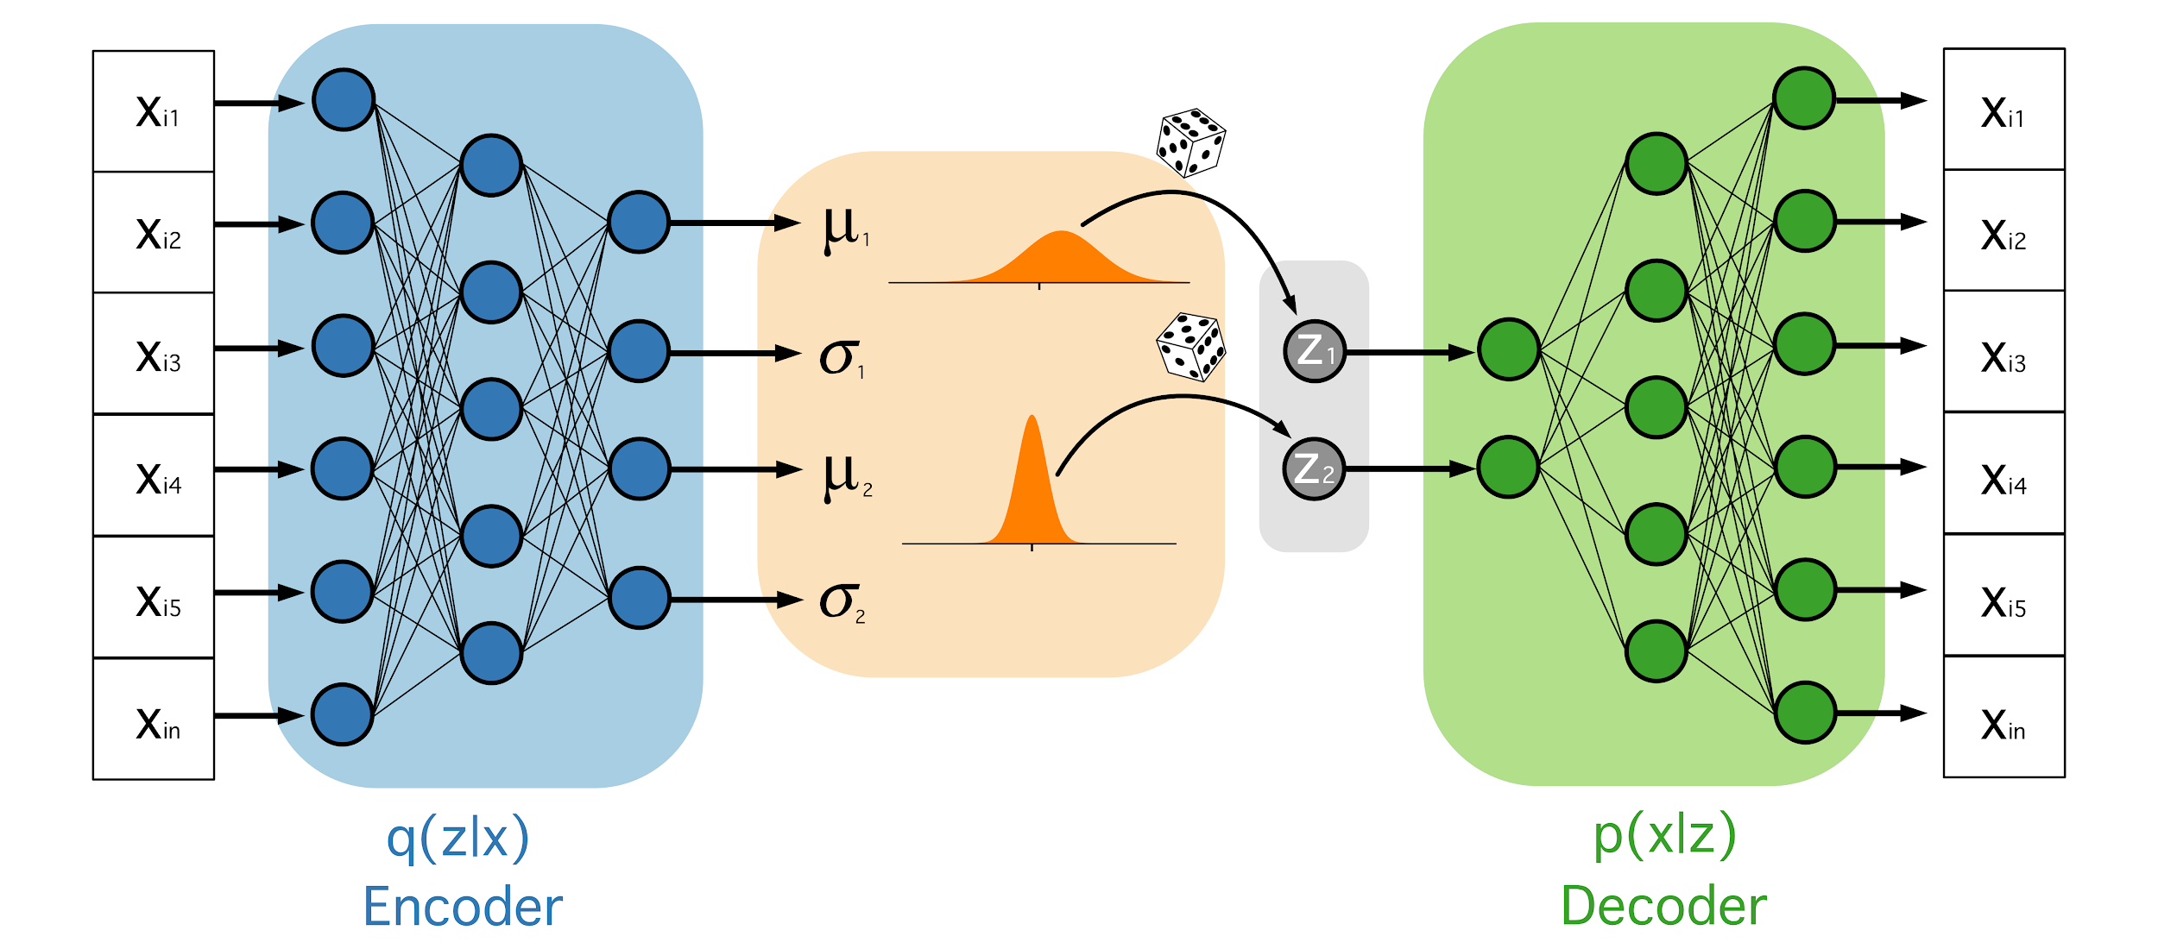
The framework: VAEs as Neural Networks

Slide 17
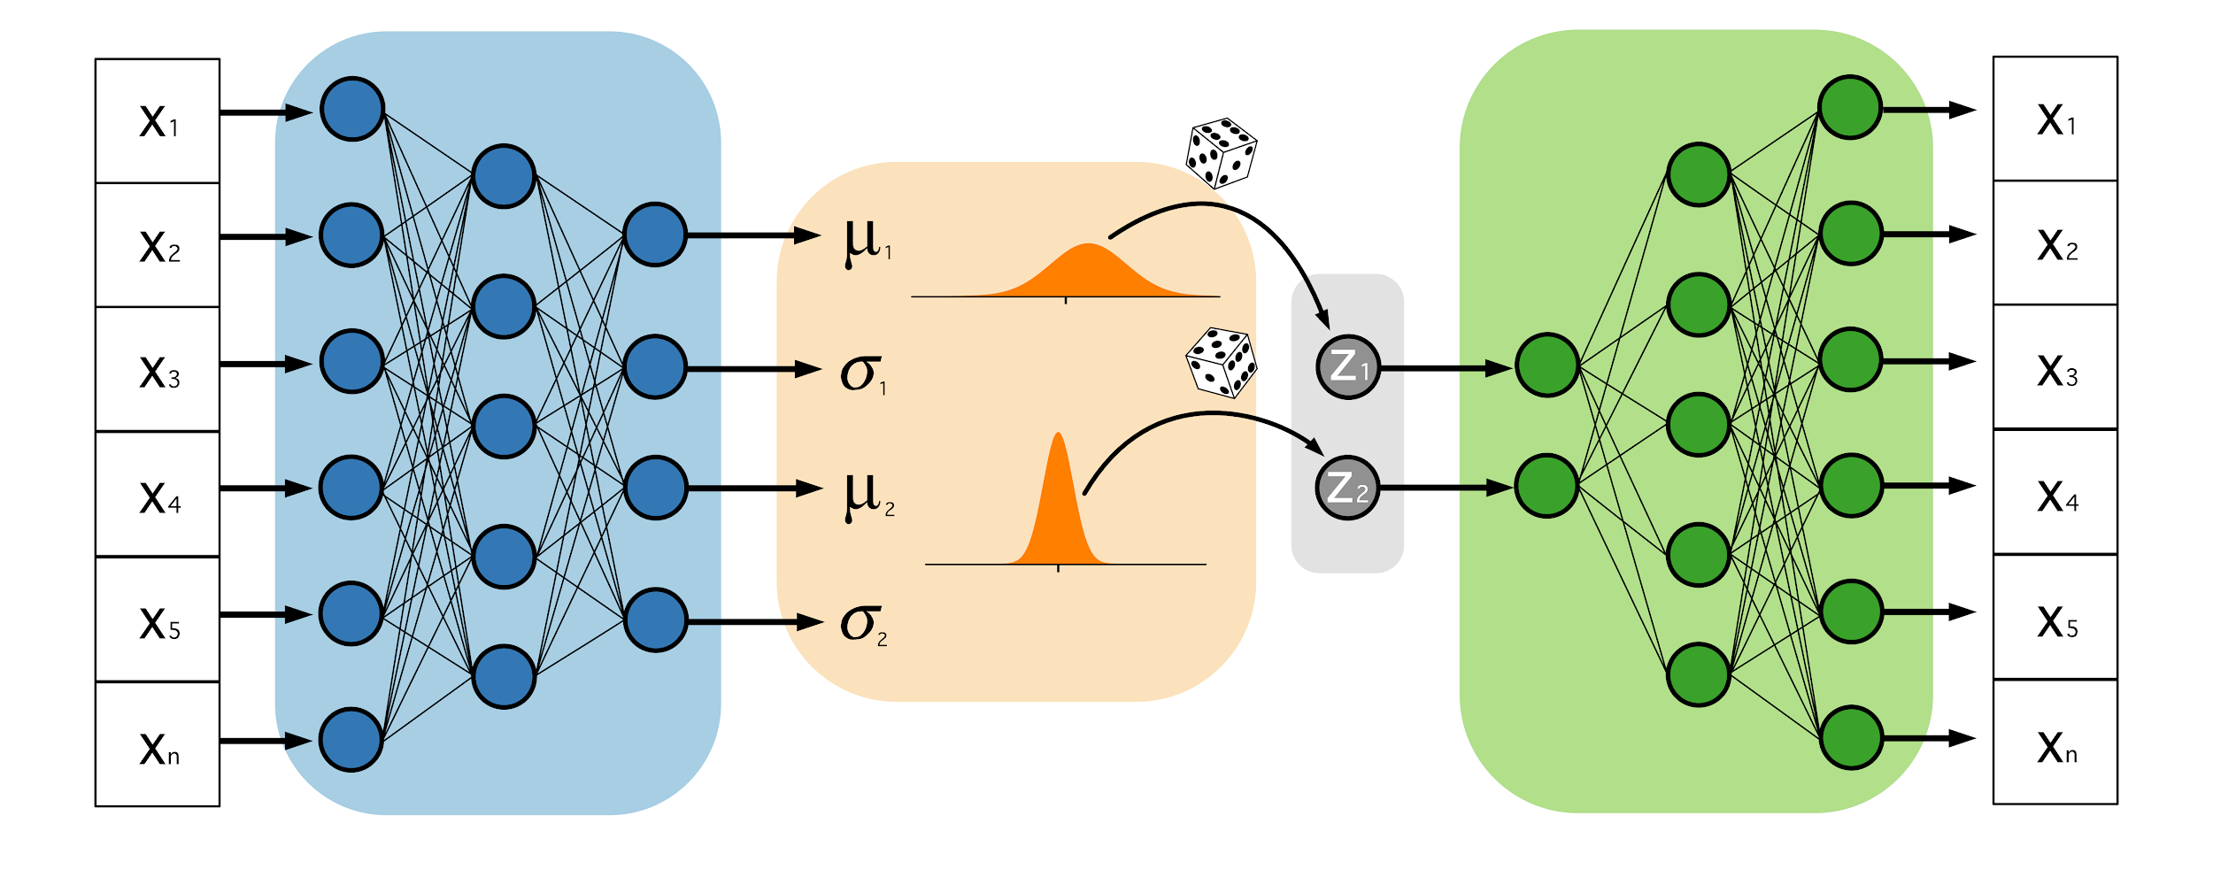
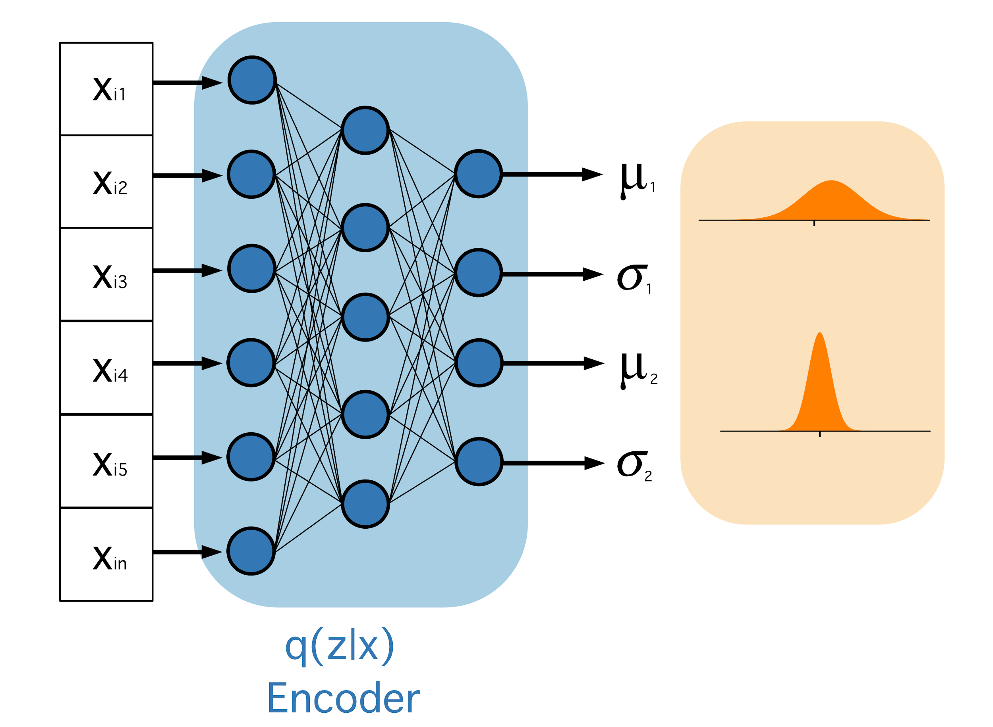
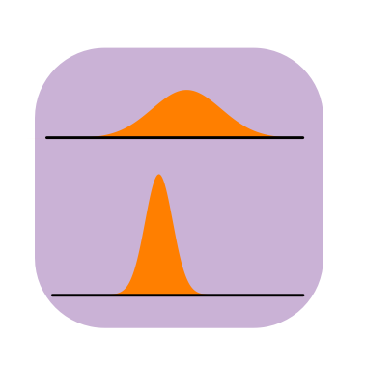
The recognition model: q(z|x)
X
p(z|x)
Approximate
posterior
True posterior

Slide 18
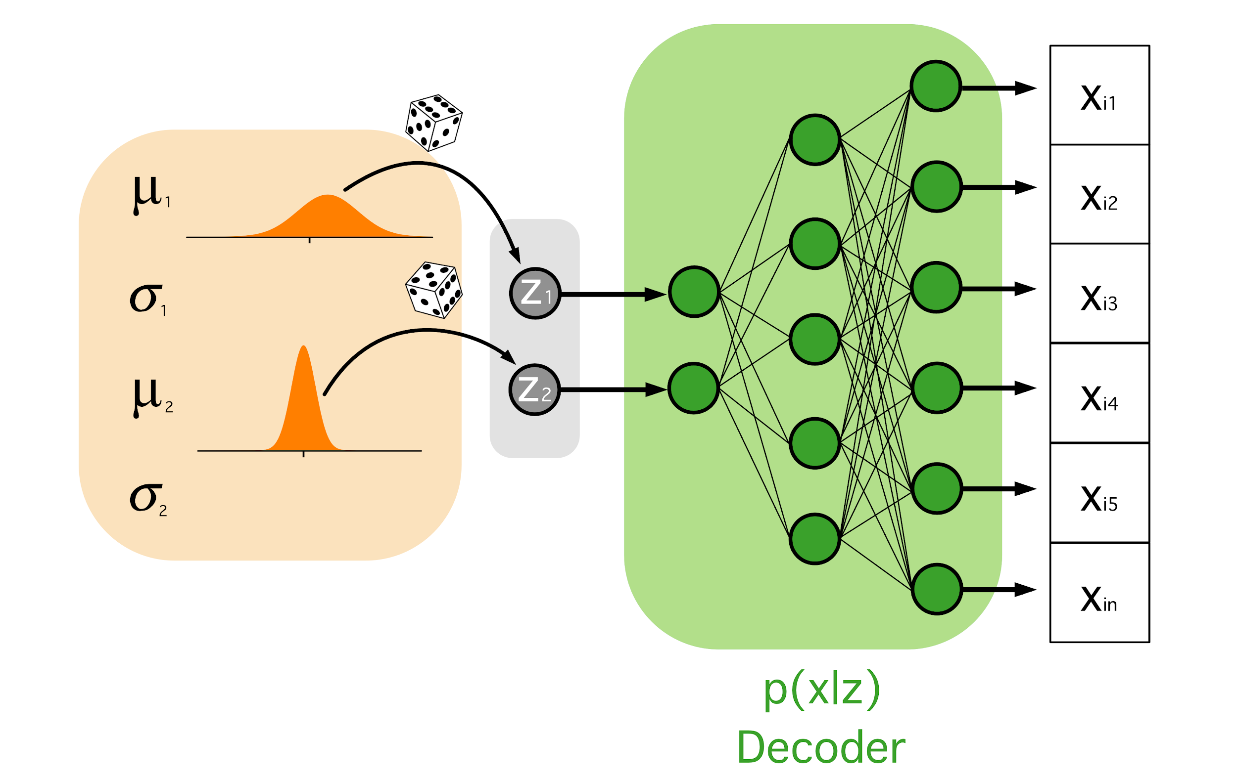
The generative model

Slide 19
Brief intro to training
Input xi
Output
0.388
0.914
0.255
0.235
0.992
0.337
0.388
0.914
0.255
0.235
0.992
0.337
0.568
0.224
0.205
0.015
0.232
0.777

Slide 20
The heart of the problem
Error
0.388
0.914
0.255
0.235
0.992
0.337
0.388
0.914
0.255
0.235
0.992
0.337
0.568
0.224
0.205
0.015
0.232
0.777
equals the probability density (or mass) of datapoint x(i) under the generative model, given z(i,l). This term is a negative reconstruction error in auto-encoder parlance.

Slide 21
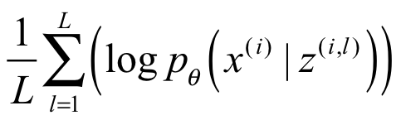
Reconstruction error
equals the probability density (or mass) of datapoint x(i) under the generative model, given z(i,l). This term is a negative reconstruction error in auto-encoder parlance.

Slide 22
The heart of the problem
Error
0.388
0.914
0.255
0.235
0.992
0.337
0.388
0.914
0.255
0.235
0.992
0.337
0.568
0.224
0.205
0.015
0.232
0.777

Slide 23
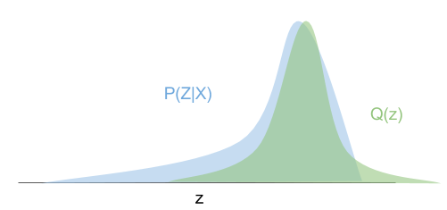
Approximation of densities
Approach: Variational Inference (VI)
Approximates a conditional density from a collection of densities
Green density attempting to fit the Blue density

Slide 24
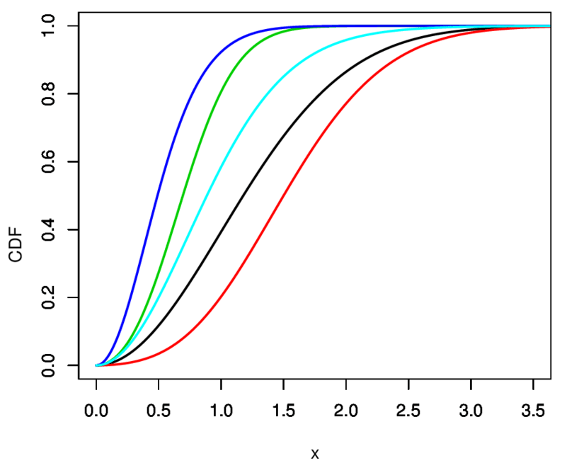
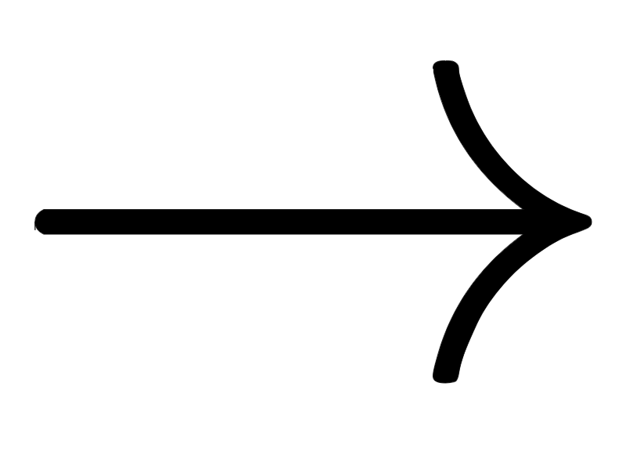
Parameterization in Variational Inference
The collection is referred to parametrization of densities.
Goal: Find density in the collection “close” to the conditional density and treat as the exact conditional density.
Family of curves

Slide 25
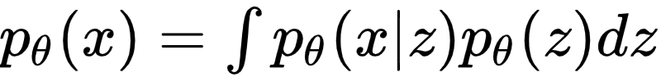
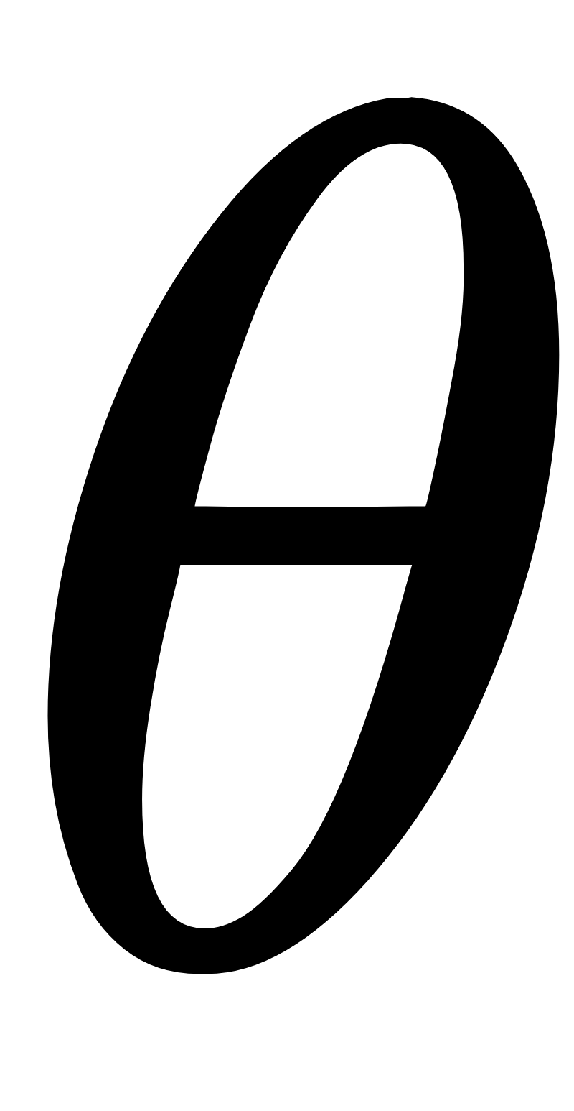
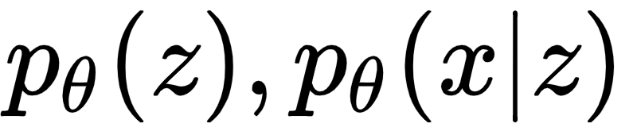
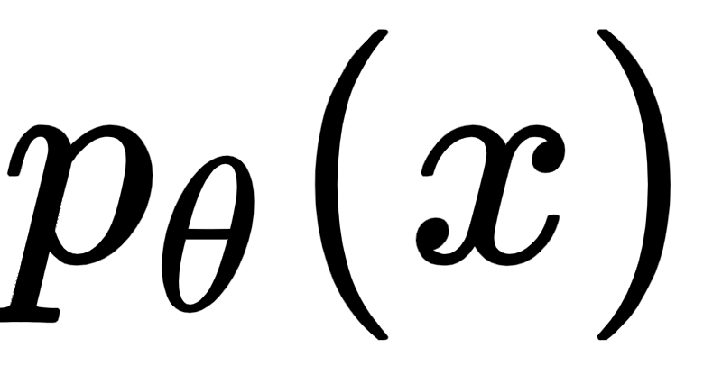
Set up for Objective function
Goal: Maximize the chance for each x in the training set X
where parametrizes a family of distributions
Challenges: Computing and
are intractable.

Slide 26
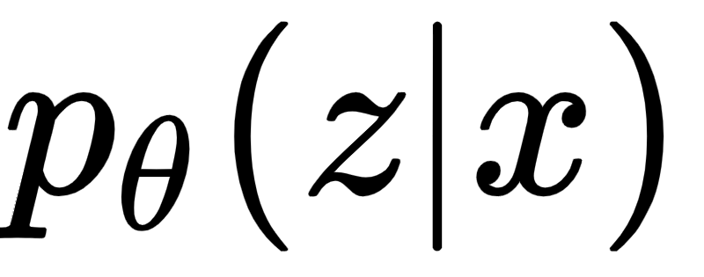
Problems to solve
Goals:
Approximate the parametric parameter
Approximate the posterior
Approximate marginal inference

Slide 27
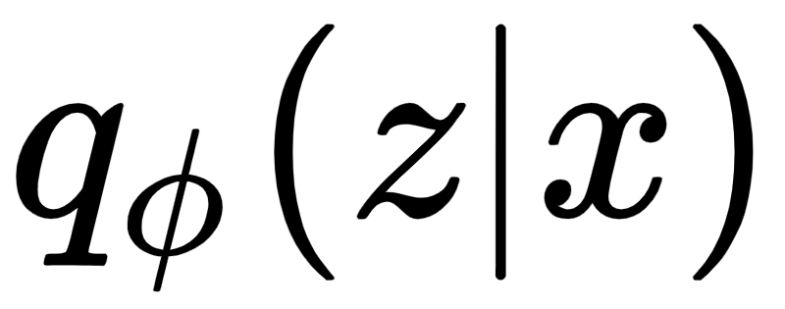
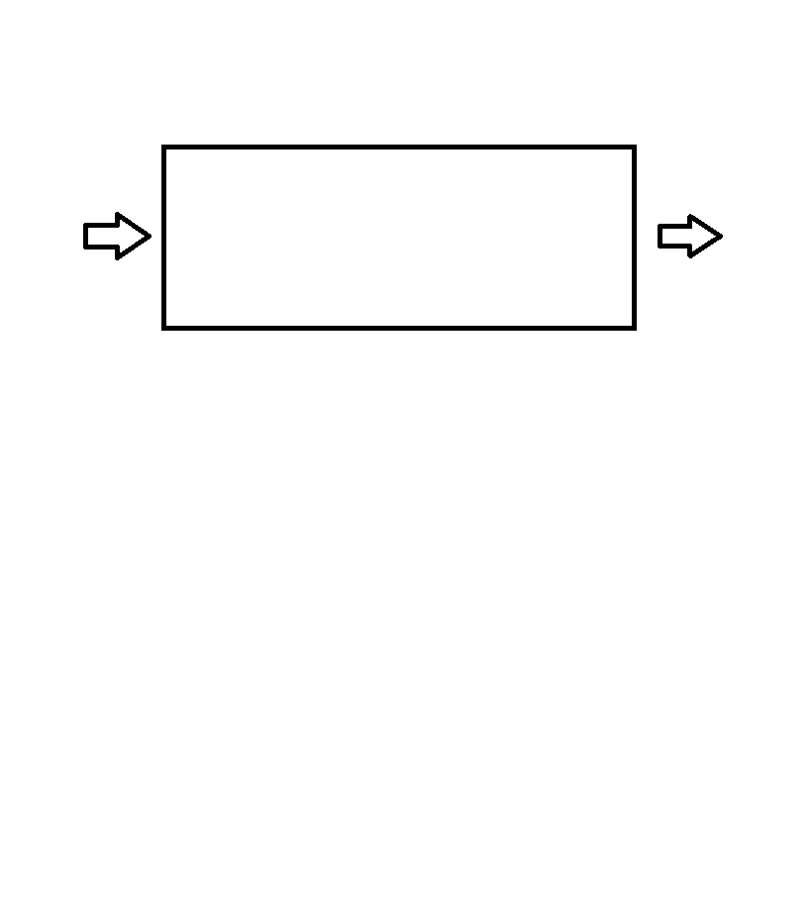
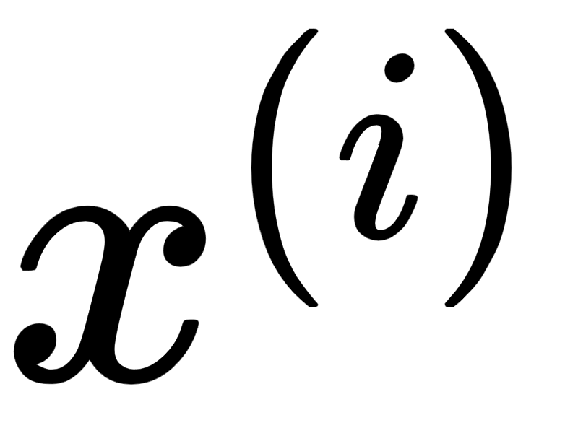
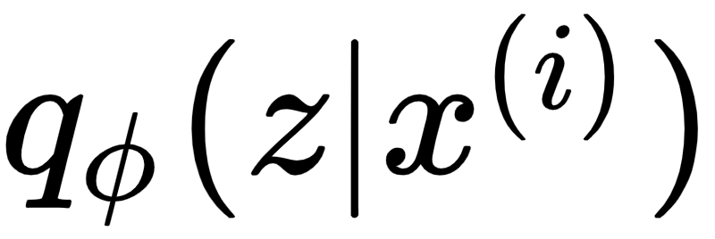
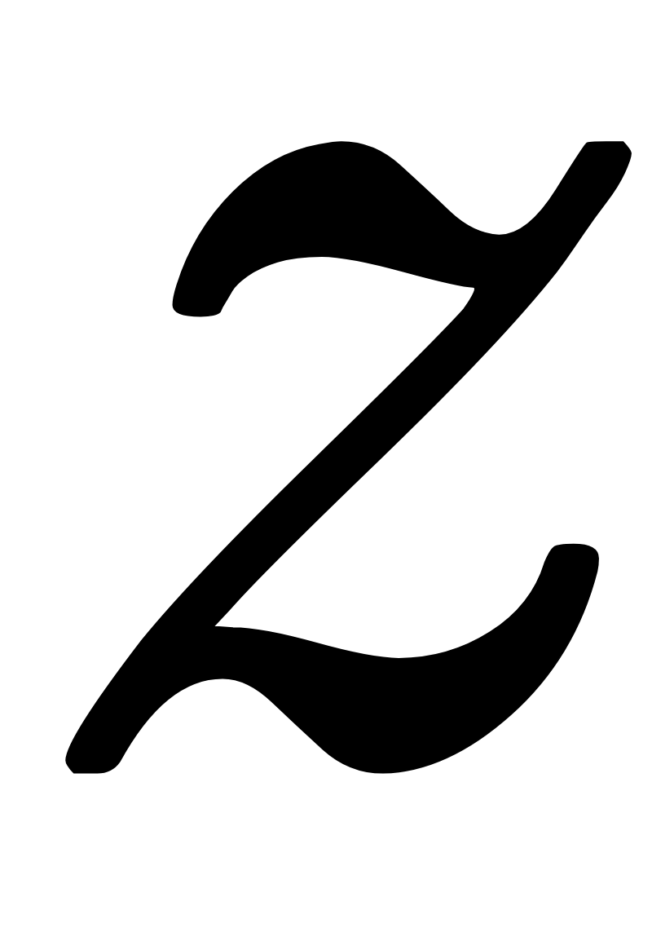
Define recognition model mathematically
Denote a recognition model (probabilistic encoder)
Approximation to the true posterior
Encoder

Slide 28
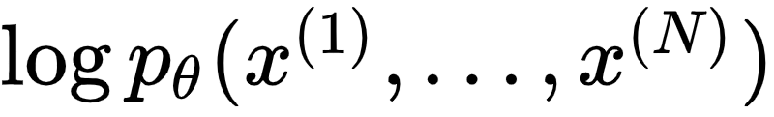
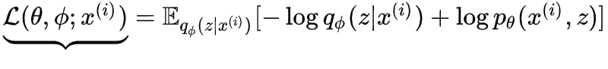
Build up to Objective function
Goal: Want to approximate marginal likelihood
First, compute marginal likelihood of individual data points
Second, approximate
Variational lower bound

Slide 29
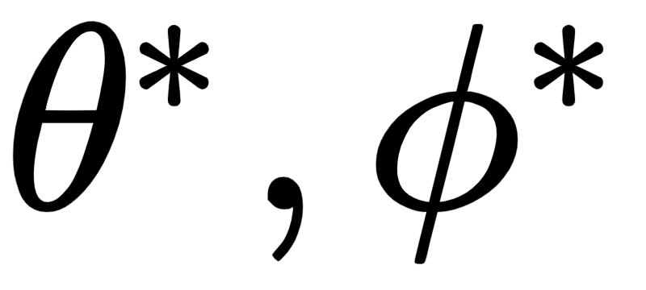
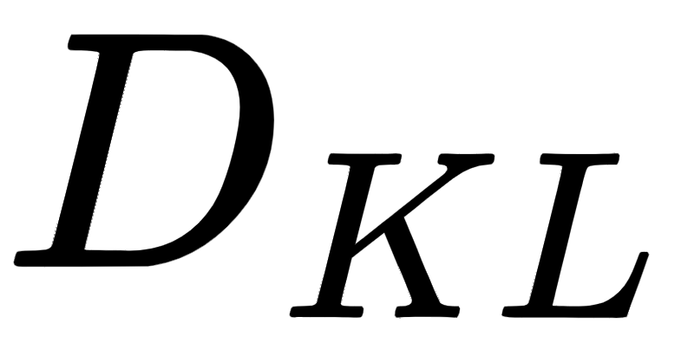
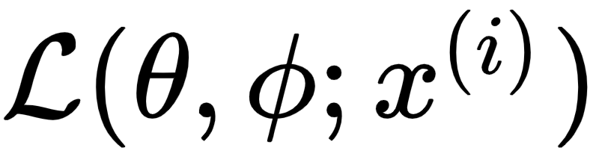
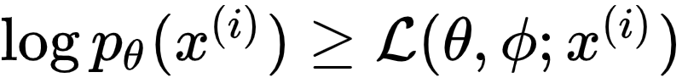
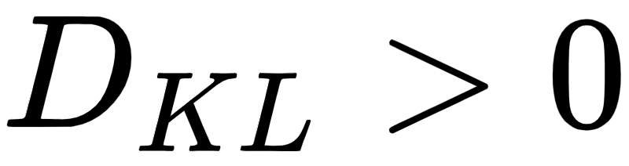
Simplification to get objective function
Recall that we want to optimize
Hope: Find optimal parameters so is small
Optimize
Next: Lower bound since

Slide 30
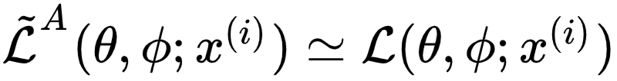
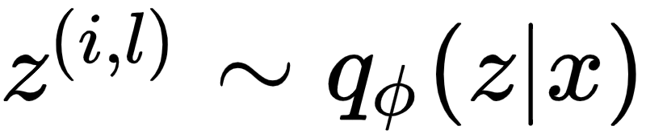
1st estimator of
1st Stochastic Gradient Variational Bayes (SGVB) estimator
Typically has high variance than the following estimator.

Slide 31
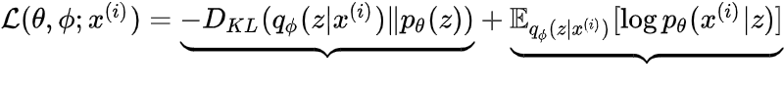
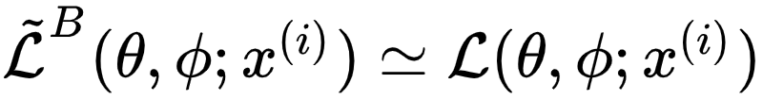
2nd estimator of
Recall
Rewrite lower bound as
2nd Stochastic Gradient Variational Bayes (SGVB) estimator
acts as a regularizer
expected reconstruction error

Slide 32




Estimator on Full Dataset
Given dataset X with N data points, estimate lower bound on X
where minibatch randomly drawn sample of M data
points from X and =
Take and use Stochastic Gradient Descent (SGD) or Adagrad [DHS10]

Slide 33

Gradient of the loss function
Aim: Train neural network using algorithm like gradient descent
We need: Gradient of loss function
Note that, as per the problem description, we are dealing with large data
Can we use minibatches or single datapoint for calculating gradient?

Slide 34

Monte Carlo Estimation
Use of repeated random sampling to obtain numerical results.
By the law of large numbers, integrals described by the expected value of some random variable can be approximated by taking the empirical mean (a.k.a. the sample mean) of independent samples of the variable.
To apply we need:
Quantity to evaluate should be an expected value
Low Variance in estimates across samples
...

Slide 35

Why low variance: Is this coin biased? (Scenario 1)
5 Samples of 10 coin toss
# Heads
 | . | . |  |  |  | . |  | . | . | 5
 | . |  | . |  | . | . | . |  | . | 4
 | . |  | . |  | . |  | . |  |  | 6
. | . | . | . | . | . |  |  |  |  | 4
 |  |  |  |  | . | . | . | . | . | 5
Average |  |  |  |  |  |  |  |  |  | 4.8

Slide 36
Why low variance: Is this coin biased? (Scenario 2)
5 Samples of 10 coin toss
# Heads
 | . | . |  |  |  | . |  | . | . | 7
. | . | . | . | . | . | . | . | . | . | 2
. | . |  | . |  | . | . | . |  |  | 4
. | . | . | . | . | . |  |  |  |  | 8
 | . | . |  |  | . | . | . | . | . | 3
Average |  |  |  |  |  |  |  |  |  | 4.8

Slide 37
Can we write gradient as expectation ? (1)
Recall the loss function:
We want to be able to write gradient as expectation of some quantity to apply Monte carlo based estimation, but
Because q is parameterized by ɸ.

Slide 38
Can we write gradient as expectation ? (2)
We can perform some algebraic manipulation (Appendix -1) to get
This term still can’t be used for learning as it usually has a very high variance.

Slide 39


What do we mean “has a high variance” ? (1)
Let us consider the Gaussian case,

Slide 40




What do we mean “has a high variance” ? (2)
Objective: Minimize loss

Slide 41

What do we mean “has a high variance” ? (3)
q tends towards point mass distribution, thus highly variable with sample

Slide 42










Backprop cannot flow through a stochastic node ??
We have a stochastic node??
Back Propagation of Error
Monte carlo estimation of gradient varies highly with the samples ‘z’.
Sampling of ‘z’ is governed by the distribution being estimated.

Slide 43


Reparameterization Trick
Reparameterize z such that z is not explicitly sampled by a distribution parameterized by ɸ
We make z deterministic and move randomness to ϵ

Slide 44

Reparameterization Trick - example
In case of Gaussian distribution, for example,

Slide 45


Backprop can flow through deterministic node
Back Propagation of Error
Back Propagation of Error

Slide 46
Appendix

Slide 47

Appendix 1 - Re-writing gradient as expectation

Slide 48

Appendix 2 - When can we do reparameterization ?

Slide 49

Appendix 3 - Computation on Slide 28

Slide 50


Appendix 4 - Computation on Slide 31

Slide 51

Autoencoder Variational Bayes Algorithm

